Slide 1
Powering The Modern UAV Architecture
Presented by: Abhishek Deshpande
Project In-charge: Dr. Zeljko Pantic
Shokoufeah Valadkhani
Chris Engel

Slide 2
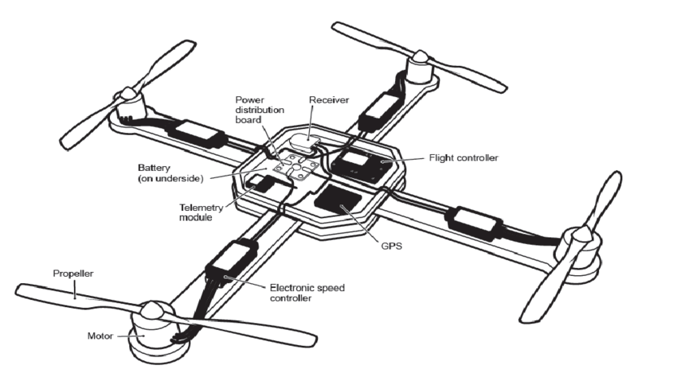
General Architecture
Components of a UAV:
Mechanical- Body, rotor blades, Frame, Motor etc.
Electrical:- Battery, MCU’s, Speed control units etc.
This is followed by various other components that include(but are not limited to) telemetry, RF, Solar etc.
Types of UAV:
Single-rotor UAVs,
Multi-rotor UAVs,
Fixed-wing UAVs,
Fixed-wing hybrid VTOL.
Reference: https://www.researchgate.net/publication/313903813_A_Review_on_Geo_Mapping_with_Unmanned_Aerial_Vehicles

Slide 3

The AIM for Research
Large level system study.
Design and modelling of individual subsystems, including realistic loss models based on practical test conditions.
Compartmentalized development, testing and modelling using real world tools(e.g.: pre-existing components)
System integration, virtual test and validation.
Hardware implementation and testing.

Slide 4
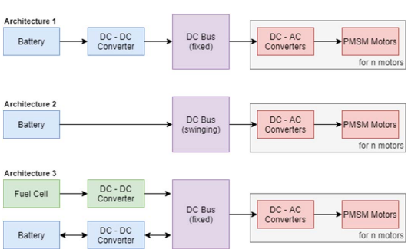




Power Management Architecture
Reference: https://ieeexplore.ieee.org/stamp/stamp.jsp?tp=&arnumber=8790566
Understanding the individual components of a UAV power delivery system….

Slide 5
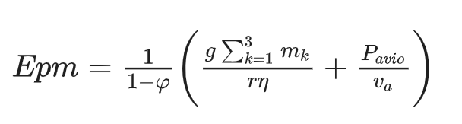
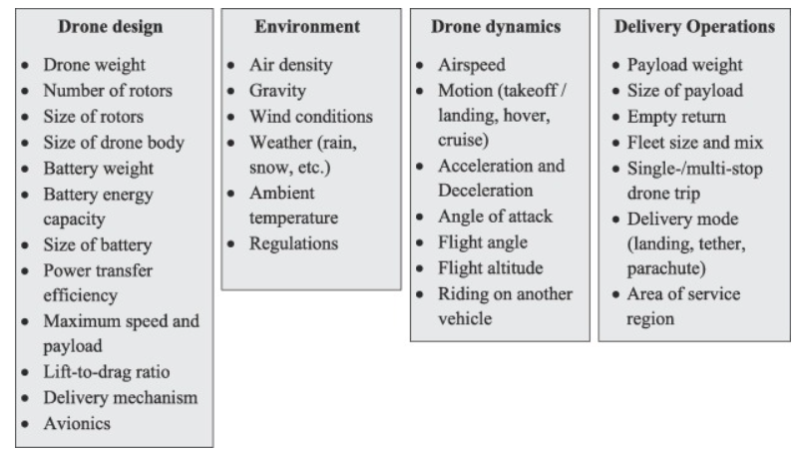
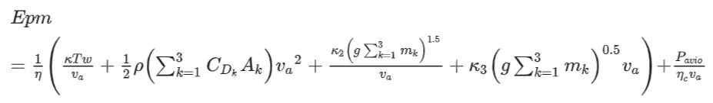
Energy Consumption Systems for UAV’s
Energy consumption of the drone is affected by various physical, environmental and structural factors.
As per the study published in [10], models of increasing order of complexity have been developed to accurately estimate the losses during the flight path of the UAV.
These models have primarily been classified as integrated / component-based.
A simple approach for incorporating lift-to-drag ratio, avionics and headwinds, with the physical factors of the UAV.
Increased model complexity due to inclusion of thrust, drag power, parasitic and induced losses due to various factors.

Slide 6

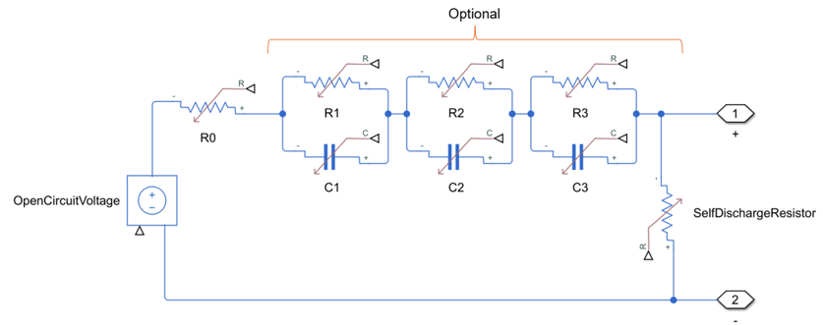
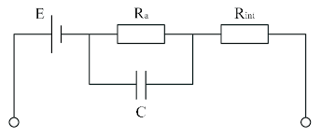
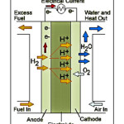
The Power Source
Battery Packs:
Commonly used electrochemical sources.
Various chemical compositions such as LiPo, NiMH, NiCd etc.
Selecting the right drone battery, typically LiPo or Li-ion, while considering factors like voltage, capacity, C-rating, and proper care, is essential for maximizing flight time and performance.
LiPo is better for performance, LiFeO4 for safety.[5]
Fuel Cells:
PEMFC operate on a chemical exchange reaction between oxygen and hydrogen, thereby providing a cleaner alternative having increased performance with rising temperature.
Complex construction, commercial feasibility concerns, physical factors affecting performance.
LiPo Battery Equivalent Model
LiPo Battery
Fuel Cell Equivalent Model
Hydrogen PEMFC

Slide 7


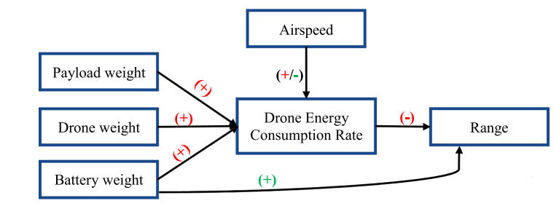
Power Delivery
The general structure contains a DC-DC converter to supply a constant voltage to the inverter that drives the motor.
A DC-bus carries out power transmission.
Common loss elements in the model include:
  Conduction: MOSFETs, diodes
  Switching: MOSFETs
  Inherent losses in wires, bus, ESD, ESR, transients etc.
Potential Solutions:
  Optimizing component selection.
  Choosing the appropriate delivery mechanisms.
  Incorporating loss mitigation strategies such as the supercapacitor bank based ESD reduction in [6] and advanced control strategies
Inverter Losses[7]
Inductor Losses
Physical factors affecting energy consumption and range[8]

Slide 8
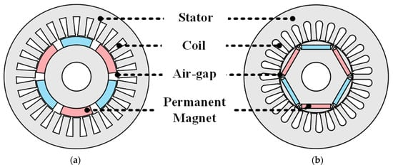
Motors and Associated Modelling
Different types of Permanent Magnet motors are utilized for UAVs.
In an SPMSM, the permanent magnets are mounted on the surface of the rotor, typically attached with adhesives or a retaining sleeve, while in IPMSM, permanent magnets are embedded inside the rotor, often in V-shaped or U-shaped configurations. This design creates both radial and tangential magnetic fields
The performance analysis of PM motors is characterized by back EMF, electromagnetic torque, losses, and efficiency.
As per a case study in [9] the characteristic comparisons of the two types of motors have been explored for EV applications:
Aspect | SPMSM | IPMSM
Torque and Efficiency | Better efficiency but lower torque density | Better torque density due to utilization of magnetic and reluctance torques, with a lowered efficiency.
Back EMF and Harmonics | Lower THD with back emf closer to a sinewave | Higher THD, with harmonics influenced by square wave flux
Losses | Lower Pcu, Higher Pcore | Higher Pcu, Lower Pcore

Slide 9
Detailed Exploration of individual research papers…

Slide 10
A.P. Thurlbeck and Y. Cao, ", Analysis and Modelling of UAV Power System Architecture“
2019 IEEE Transportation Electrification Conference and Expo (ITEC), Detroit, MI, USA, 2019,
pp. 1-8, doi: 10.1109/ITEC.2019.8790566
The Crux of the Authors’ Work:
Developed a comprehensive modeling framework for power systems in VTOL UAVs.
Designed an example UAV platform to demonstrate applications of the model. Compared multiple power system architectures based on power loss, craft mass, and flight time.
Incorporated a realistic mission profile to analyze system losses and required input energy. Simulated the impact of hydrogen fuel cells and battery architecture, showing advantages for payload capacity and flight time. Conducted optimization studies to refine UAV power system design.
Utilized dynamometer testing with a permanent magnet synchronous motor (PMSM) and a DC-AC inverter to validate the modeling approach.
Simulated flight under various mission conditions (ascending, descending, hovering, cruising) to assess energy efficiency and performance.

Slide 11
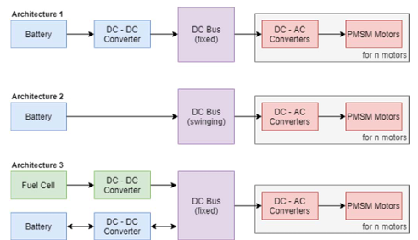
Analysis and Modeling of UAV Power System Architectures - Introduction
In this part, I am going to mainly focus on the aspects of loss modelling of the individual subsystems and the approach taken by the authors for the same.
There are three main architectures and their performances are discussed in this paper.
  Architecture 1: DC-DC converter with fixed DC bus. Need to investigate loss structuring on the converter.
  Architecture 2: DC bus voltage varies with battery SOC.
  Architecture 3: Hybrid powered system. Requires precise control for achieving desired transient response.

Slide 12


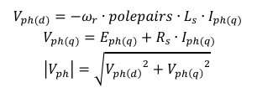
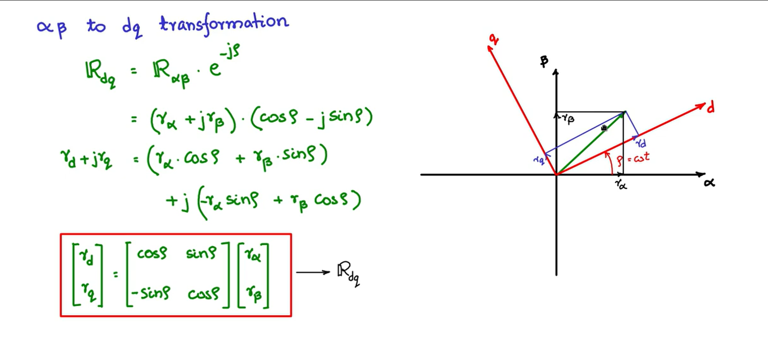
Analysis and Modeling of UAV Power System Architectures – PMSM Motor Analysis
Inverter based FOC/SVM controlled PMSM motors have been identified as an efficient option in terms of cost and utilization.
Note that d-q reference frame analysis was done in the controls part.
Back EMF = E_{ph(q)} = k_{e}*W_{r} (rotor speed*back emf const.(Vs/rad)
If P_{mech} are the combined mechanical losses then, we have
Where,
  T_{em} = electromechanical torque comprised of no load and loaded torque
  Ls, Rs: Stator inductance and resistance
The total losses of the inverter are given by,

Slide 13
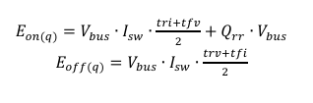


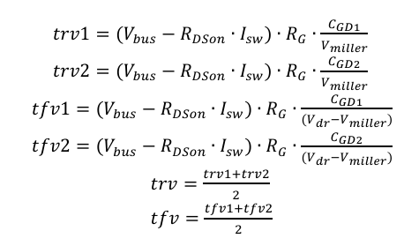


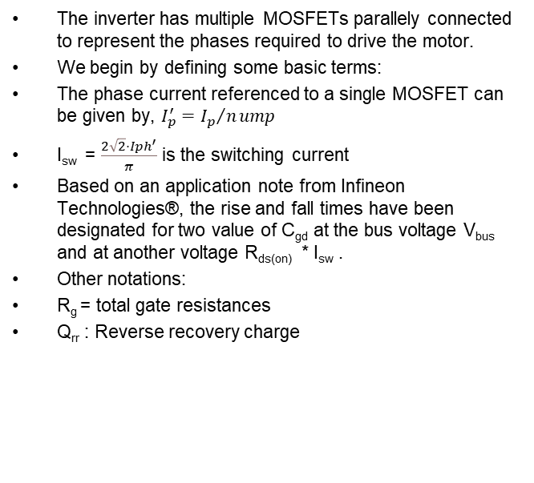
Analysis and Modeling of UAV Power System Architectures – DC-AC Inverter Analysis
The inverter has multiple MOSFETs parallely connected to represent the phases required to drive the motor.
We begin by defining some basic terms:
The phase current referenced to a single MOSFET can be given by, $I_{p}^{′}={I_{p}}/nump$
I_{sw} = $\frac{2\sqrt{2}⋅Iph^{′}}{π}$ is the switching current
Based on an application note from Infineon Technologies®, the rise and fall times have been designated for two value of C_{gd} at the bus voltage V_{bus} and at another voltage R_{ds(on)} * I_{sw} .
Other notations:
R_{g} = total gate resistances
Q_{rr} : Reverse recovery charge
The switching losses for MOSFET and diode ( q and d) are given as follows:

Slide 14
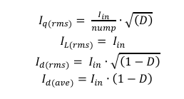
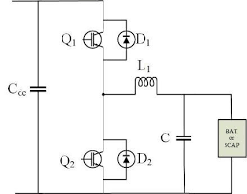
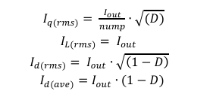
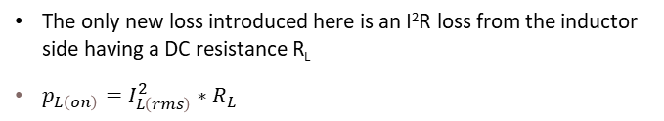
Analysis and Modeling of UAV Power System Architectures – Boost and Half Converter
Average and RMS currents of the boost converter are given by:
Similarly, for the half-bridge buck converter:
The only new loss introduced here is an I²R loss from the inductor side having a DC resistance R_{L}
$p_{L\left(on\right)}=I_{L\left(rms\right)}^{2}∗R_{L}$
Note: MOSFET and diode conduction and switching losses are calculated as before
Where, I_{in} is the current flowing into the converter from the source and I_{out} is the current flowing out of the converter back to the battery.
Reference: https://encrypted-tbn0.gstatic.com/images?q=tbn:ANd9GcSNz4TV2IywAXYskwuiqgBocCo38CKtBLcKCQ&s

Slide 15
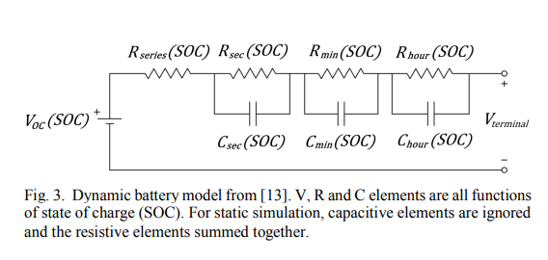
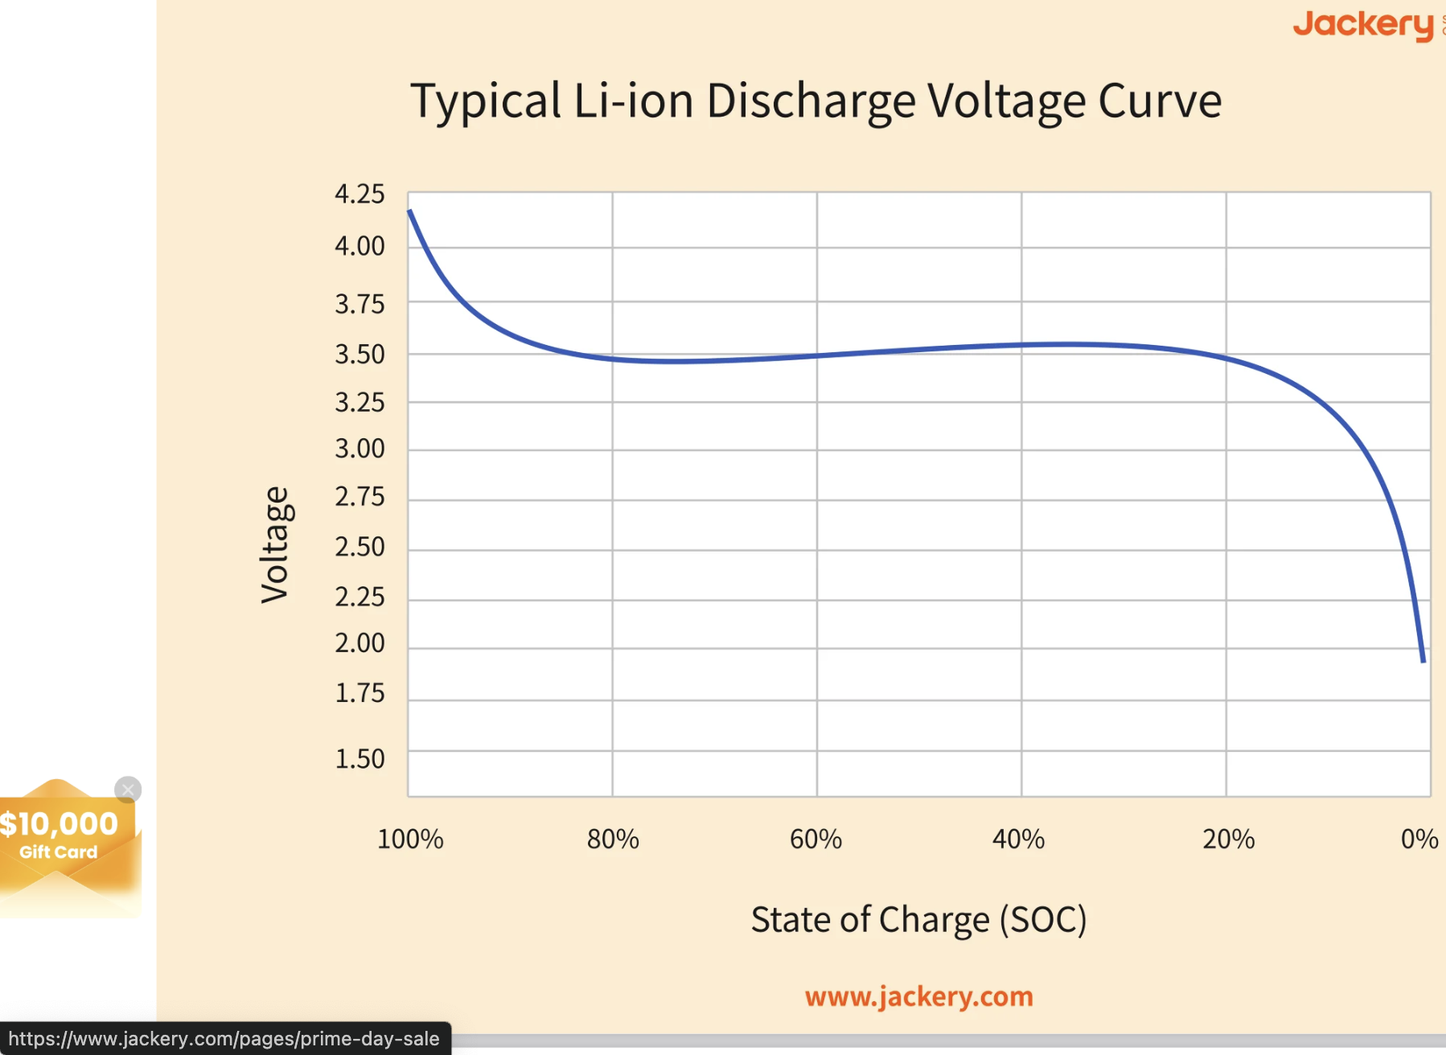
Analysis and Modeling of UAV Power System Architectures – Battery Modelling
Purpose of the Equation:
Models the battery's electrical behavior dynamically using an equivalent circuit approach. Captures variations in voltage (V), resistance (R), and capacitance (C) as a function of the State of Charge (SOC).
Logarithmic-Polynomial Interpolation:
Uses a polynomial function in terms of ln(SOC) to approximate circuit parameters. The summation represents a sixth-order polynomial fit, ensuring accuracy in modeling.
Application in Static and Dynamic Models:
  Dynamic Simulation: Uses full equation to model real-time variations.
  Static Simulation: Ignores capacitance and sums resistances into a single equivalent resistance 𝑅_{𝑠𝑡𝑎𝑡𝑖𝑐}.
Adaptation for High Discharge Rates
The reference battery had a max discharge rate of 1C.
To simulate high discharge rates (e.g., 5C or higher), resistance was reduced by a factor of 5.
Ensures accurate modeling for high-power applications like Li-Po battery packs.

Slide 16
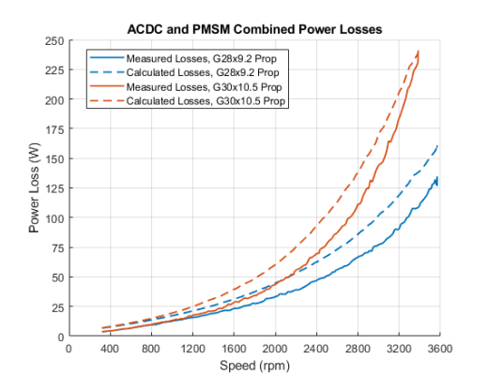
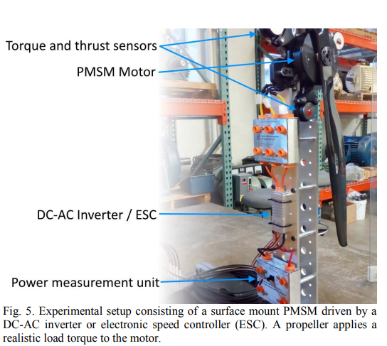
Analysis and Modeling of UAV Power System Architectures – Experimental Validation
Experimental Setup – A PMSM motor (T-Motor U10II KV100) was driven by an FOC-based ESC/DC-AC inverter (T-Motor Alpha 80A HV), with an RC Benchmark Dynamometer measuring thrust, torque, speed, and power.
Motor and Inverter Analysis – Mechanical losses were determined through a no-load test, while the MOSFET arrangement and model parameters were identified for the inverter. Equivalent circuit parameters were also obtained for the motor.
Testing with Propellers – Two propellers (G28x9.2 and G30x10.5) were used to apply realistic loads. The motor speed was gradually increased to rated conditions to minimize acceleration-induced torque.
Losses and Efficiency Measurement – Power loss and efficiency were measured from inverter input to motor shaft, with experimental results compared to model predictions over the same torque and speed range.
Model Validation – The model closely matched experimental results across the speed range, though it slightly overestimated losses at lower speeds. It was deemed sufficiently accurate for power system design and analysis.
Inference: The losses while doing theoretical calculations were overestimated and were practically varying less drastically when experimented on practically.

Slide 17
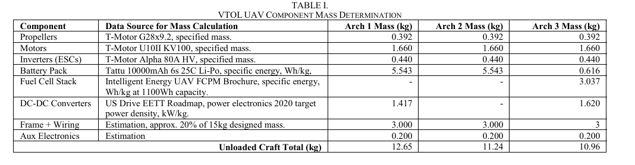
Analysis and Modeling of UAV Power System Architectures – Loss Distribution
Model Configuration Parameters:
Weight of loaded craft = 15kg
Maximum thrust = 24kgf
Battery: 3.7V, 2200mAh LiPo – 12 series and 9 parallel configuration
For a 4-propeller VTOL UAV, the following configurations were taken:

Slide 18
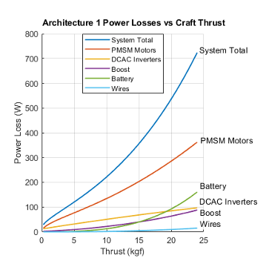
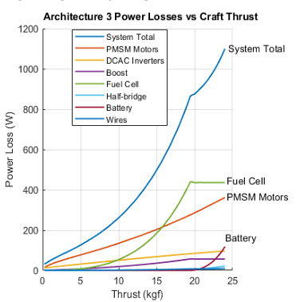
Analysis and Modeling of UAV Power System Architectures – Loss Distribution
Based on the plots for losses of architectures 1 and 3, a comparison can be drawn:
Arch 1 | Dominant Losses: PMSM motor losses dominate, with battery losses increasing at higher thrust. Imp. Point: Battery provides stable power, but efficiency drops at high thrust. Overall efficiency: Moderate
Arch 2 | Dominant Losses: PMSM motor remains the dominant loss, with no boost converter losses Imp. Point : The intermediate losses still are sizable but overall loss is reduced. Overall efficiency: Good
Arch 3 | Dominant Losses: Fuel cell losses dominate, with increased wiring losses due to high currents Imp. Point : Fuel cell offers extended endurance but at the cost of significantly higher losses, due to added components Overall efficiency: Bad

Slide 19
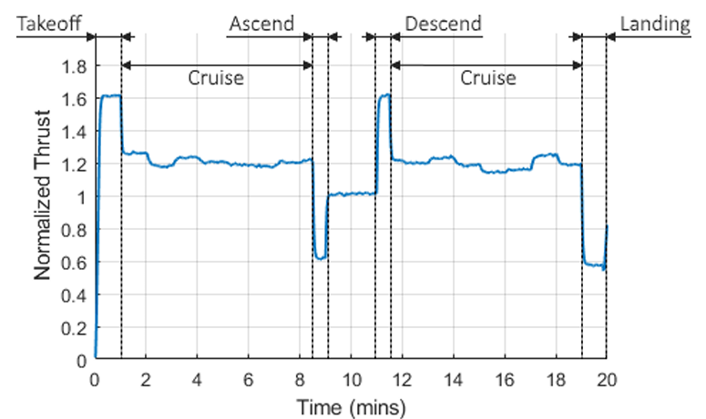
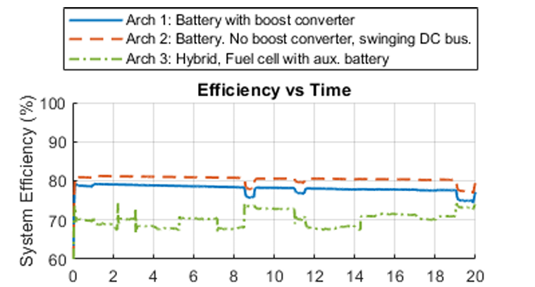
Analysis and Modeling of UAV Power System Architectures – Mission Profile Simulations
Normalized thrust is defined as the ratio of actual thrust to craft mass. We can observe the stability of the system during the cruise system and the increased/ decreased response during ascend and descent.
Arch 1 | Unloaded Weight and Payload:12.65 kg (Unloaded) 2.35 kg (Payload) Efficiency: Lower than Architecture 2 (~81-82%) Reason for good/bad efficiency: Moderate losses due to the boost converter adding conversion losses.
Arch 2 | Unloaded Weight and Payload:11.24 kg (Unloaded) 3.76 kg (Payload) Efficiency: 83% (best) Reason for good/bad efficiency: Best efficiency because it has no boost converter, minimizing conversion losses.
Arch 3 | Unloaded Weight and Payload:10.96 kg (Unloaded) 4.04 kg (Payload) Efficiency: Lowest (70-75%) Reason for good/bad efficiency: Poor efficiency due to fuel cell losses, extra losses in the boost and half-bridge converters, and additional charging losses during cruising.

Slide 20
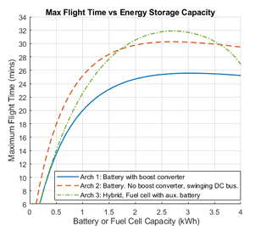

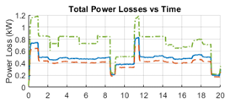
Analysis and Modeling of UAV Power System Architectures – Maximum Flight Time and Losses
Arch | Flight Time (at 3kWh) | Power Losses
1 | 25.5 min, suffers from converter losses, better than 3 but worse than 2 for short flights. | Moderate power losses, higher than Arch. 2 due to boost conversion losses
2 | 30 min, balances endurance and efficiency. | Lowest power losses over the entire mission profile
3 | 32 min at 2.7kWh, but has a higher energy consumption. | Highest power losses, especially during cruise and ascent due to fuel cell inefficiencies and charging losses
What are these constants?

Slide 21
Analysis and Modeling of UAV Power System Architectures – Scope of Improvement
The DC bus voltage optimization can be improved by using a universal step-up/step-down converter to enhance efficiency while maintaining the required power levels for VTOL UAV applications.
The accuracy of MOSFET switching energy calculations can be improved by experimentally measuring turn-on and turn-off energies instead of relying on approximate gate capacitance values.
The battery model can be refined by using logarithmic-polynomial interpolation rather than high-discharge rate battery pack data to enhance accuracy. (Need to study battery modelling in more detail)
The fuel cell mass considerations can be improved by using UAV-specific fuel cell stack data into the simulations.
Loss reduction in the DC-DC converter can be achieved by optimizing the power system architecture to minimize additional thrust requirements and output power losses.
Simulation accuracy can be further enhanced by using improved parameter estimation methods and experimental validation for better system modeling.

Slide 23
Mathematical model of a proton-exchange membrane (PEM) fuel cell
Introduction:
Proton Exchange Membrane Fuel Cells (PEMFCs) offer a promising clean energy solution for transportation by replacing traditional fossil fuels.
This paper develops a detailed Simulink model of a PEMFC integrated with a variable load for comprehensive analysis.
Mathematical modeling is crucial for understanding complex PEMFC dynamics and optimizing their performance and design.
The developed PEMFC model is validated against experimental data and used to analyze both steady-state and dynamic behavior under various operating conditions.

Slide 24

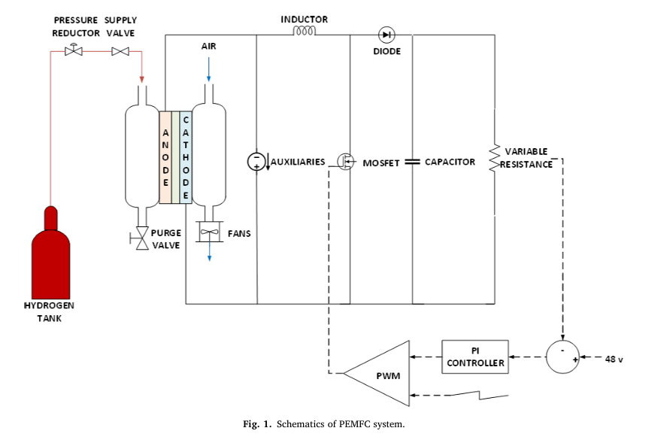
Mathematical Model of a Proton-Exchange Membrane (PEM) Fuel Cell
The PEMFC model is developed in MATLAB/Simulink and validated using data from the Horizon H-500XP fuel cell stack, which includes a 500W stack, a 12V startup battery, and super-capacitors.
The model simulates the electrochemical process, where hydrogen reacts with oxygen to generate power, with open-circuit voltage calculated using the Nernst equation under steady-state, isothermal conditions.
Generated power is regulated by a 48V DC-DC boost converter with PI-PWM control and is dissipated through a variable resistive load, ensuring stable operation.
Auxiliary power consumption is accounted for, including a controlled current source that simulates fan power variations from 36.5W at 23 C to 52W at 65 C, with constant reactant partial pressures and membrane humidity assumed.
When a load is applied, external current flows, causing a voltage drop, while some hydrogen diffusion leads to current loss, meaning only the external current is delivered to the load.

Slide 25


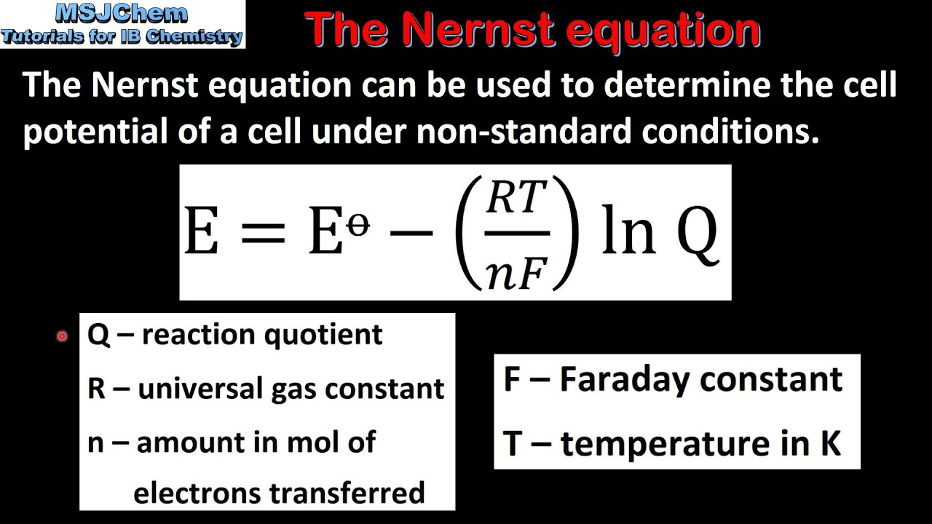

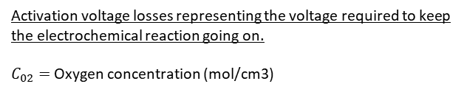

Mathematical Model of a Proton-Exchange Membrane (PEM) Fuel Cell – Analytical Equations
Initial Conditions
Standard OC-voltage given based on the variation of Gibbs energy w.r.t Faraday’s constant at 298.15 K and 1 bar pressure
Standard OC-voltage given evaluated under varying conditions
Where,
R: Universal gas constant
PH2 and PO2: Partial pressures of hydrogen and oxygen
Ts: Stack temperature
RT/2F: adjusting the reactant and product pressures
The term in orange is to adjust voltage variations due to entropy variations
$$I_{tot}=I_{ext}+I_{Loss}$$
Upon application of an external load, I_ext causes a voltage drop, followed by the generation of a loss due to electrochemical reaction in the membrane, causing stray electrons to pass via. Membrane rather than the load.
Activation voltage losses representing the voltage required to keep the electrochemical reaction going on.
$C_{02}=$ Oxygen concentration (mol/cm3)

Slide 26

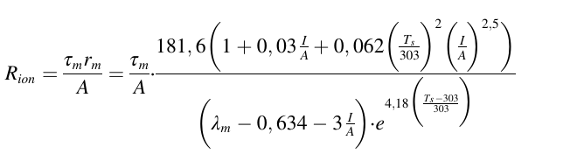

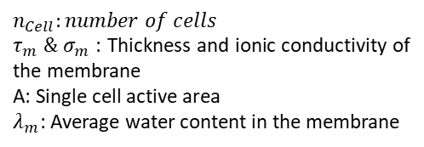
Mathematical Model of a Proton-Exchange Membrane (PEM) Fuel Cell – Analytical Equations
There are various resistive equations modelled into the loss model, some of the important ones are as follows:
$$ΔV_{Ω}=R_{n}I+\left[R\left(ⅇlⅇ\right)+R\left(Con\right)\right]I_{ext}$$
Total Ohmic voltage in the cell
Equivalent Activation Resistance
$$n_{Cell}:number of cells$$
$τ_{m} \&{ σ}_{m }$: Thickness and ionic conductivity of the membrane
A: Single cell active area
$λ_{m}$: Average water content in the membrane
Resistance to the flow of the ions into the membranes
Equivalent Concentration Resistance

Slide 27
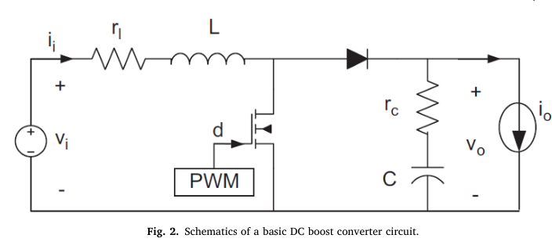


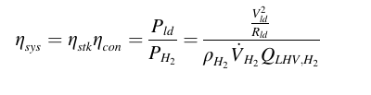
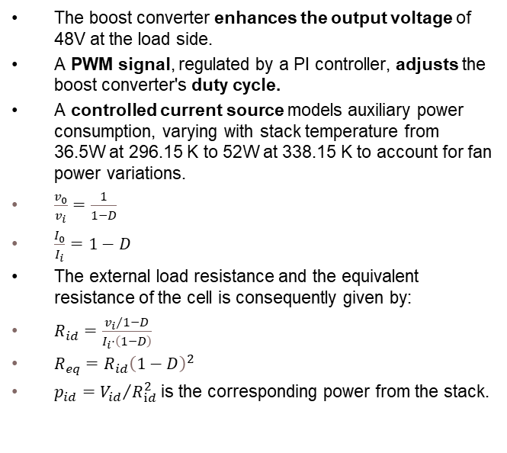
Mathematical Model of a Proton-Exchange Membrane (PEM) Fuel Cell – Boost Converter
The boost converter enhances the output voltage of 48V at the load side.
A PWM signal, regulated by a PI controller, adjusts the boost converter's duty cycle.
A controlled current source models auxiliary power consumption, varying with stack temperature from 36.5W at 296.15 K to 52W at 338.15 K to account for fan power variations.
$\frac{v_{0}}{v_{i}}=\frac{1}{1−D}$
$\frac{I_{0}}{I_{i}}=1−D$
The external load resistance and the equivalent resistance of the cell is consequently given by:
$R_{id}=\frac{{v_{i}}/1−D}{I_{i}⋅\left(1−D\right)}$
$R_{eq}=R_{id}{\left(1−D\right)}^{2}$
$p_{id}={V_{id}}/{R_{ⅈd}^{2}}$ is the corresponding power from the stack.
The efficiency of the boost converter is given as:
Where, efficiency of the cell stack is given by:
The overall efficiency of the system is given as:

Slide 28
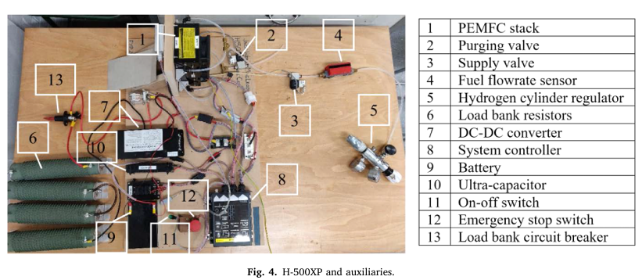
Mathematical Model of a Proton-Exchange Membrane (PEM) Fuel Cell – Test Setup
The H-500XP PEM fuel cell stack has 30 cells, delivering up to 600 W, with an operating current range of 0–33.5 A and a voltage range of 15–28.8 V.
The stack is self-humidified, using high-purity hydrogen (99.99% dry H₂) and air for the reaction, with cooling provided by two axial fans.
Key components include a hydrogen cylinder, purging valves, battery, supercapacitor bank, boost converter, external load bank, and system controller.
The controller regulates stack temperature via fan speed, manages fuel purging and supply, and prevents over-current, low voltage, and overheating.
A DC boost converter maintains a stable 48 V output across the load, with power dissipated as heat in resistive loads through the Joule effect.

Slide 29
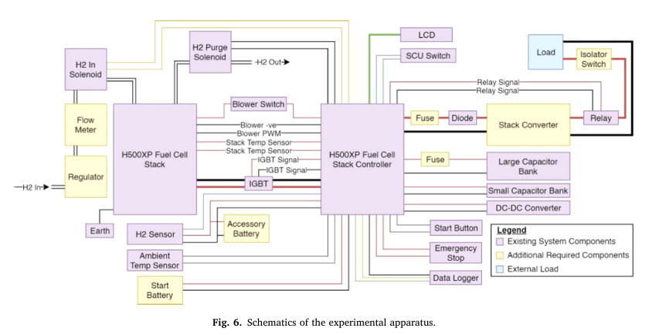
Mathematical Model of a Proton-Exchange Membrane (PEM) Fuel Cell – Test Method
The hydrogen supply is regulated at 1.5 bar absolute, and the system is monitored using dedicated software.
Load variation is controlled from open circuit to a minimum resistance of 4.63 Ω, with a 1-minute stabilization period before recording data.
Measurements are taken over 5 minutes per load, including stack voltage, current, power, temperature, and battery voltage.
A digital flowmeter records the hydrogen flow rate between the cylinder and the stack inlet.

Slide 30
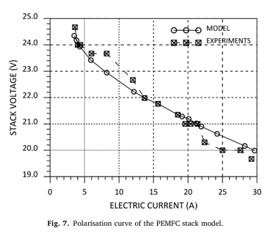
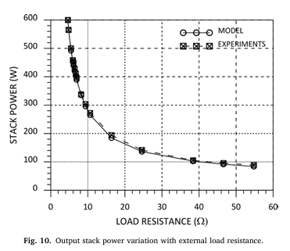
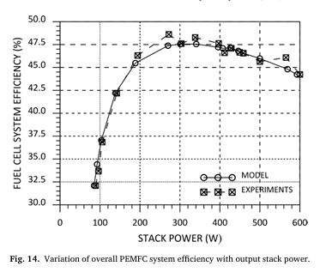
Mathematical Model of a Proton-Exchange Membrane (PEM) Fuel Cell – Results
The polarization curve represents the steady-state behavior of the fuel cell, showing a close match between model predictions and experimental results.
The maximum discrepancy between the model and experiments is 3.1%, indicating good agreement.
At the lowest external load resistance of 4.63 Ω, the fuel cell reaches a maximum current of 29.2 A at 19.67 V, producing 574.4 W of power.
As the external load resistance decreases, the stack output power increases, following similar trends in both model and experimental results.
The maximum discrepancy observed between the model and experiments is 5.7%, showing reasonably accurate predictions.
Higher power demand results in increased hydrogen consumption, with a linear dependence between stack current and hydrogen flow rate.
The peak efficiency is observed at around 50% of the rated power output, reaching 47.6% (model) and 48.6% (experiment).
Efficiency declines at higher power levels due to increased system losses, but the model remains within a 4.6% discrepancy from experimental data.
Further improvements, such as optimizing stack temperature, could enhance efficiency while balancing operational costs.

Slide 31
References:
https://www.materialsciencejournal.org/vol17no2/effect-of-temperature-on-the-performance-factors-and-durability-of-proton-exchange-membrane-of-hydrogen-fuel-cell-a-narrative-review/
https://www.mathworks.com/help/simscape-battery/ref/battery_equivalent_circuit_eq_circ.png
https://www.ufinebattery.com/blog/drone-batteries-everything-you-need-to-know/
https://encrypted-tbn0.gstatic.com/images?q=tbn:ANd9GcT6kA8P3x9AP0CHlhJGe0KIkXjnj0ySXrv_Ng&s
https://papers.ssrn.com/sol3/papers.cfm?abstract_id=4324196
https://www.researchgate.net/publication/224160572_DC-bus_power_quality_for_UAV_systems_during_generator_fault_conditions
https://ieeexplore.ieee.org/stamp/stamp.jsp?tp=&arnumber=8790566
https://www.sciencedirect.com/science/article/pii/S1361920920308531
https://www.mdpi.com/1996-1073/16/3/1306#:~:text=SPMSMs%20use%20only%20magnetic%20torque,wide%20compared%20with%20the%20SPMSM
https://www.sciencedirect.com/science/article/pii/S1361920920308531
https://www.sciencedirect.com/science/article/pii/S2666202721000483?ref=pdf_download&fr=RR-2&rr=909f81bf0d50b06f

Slide 32


